Slide 1

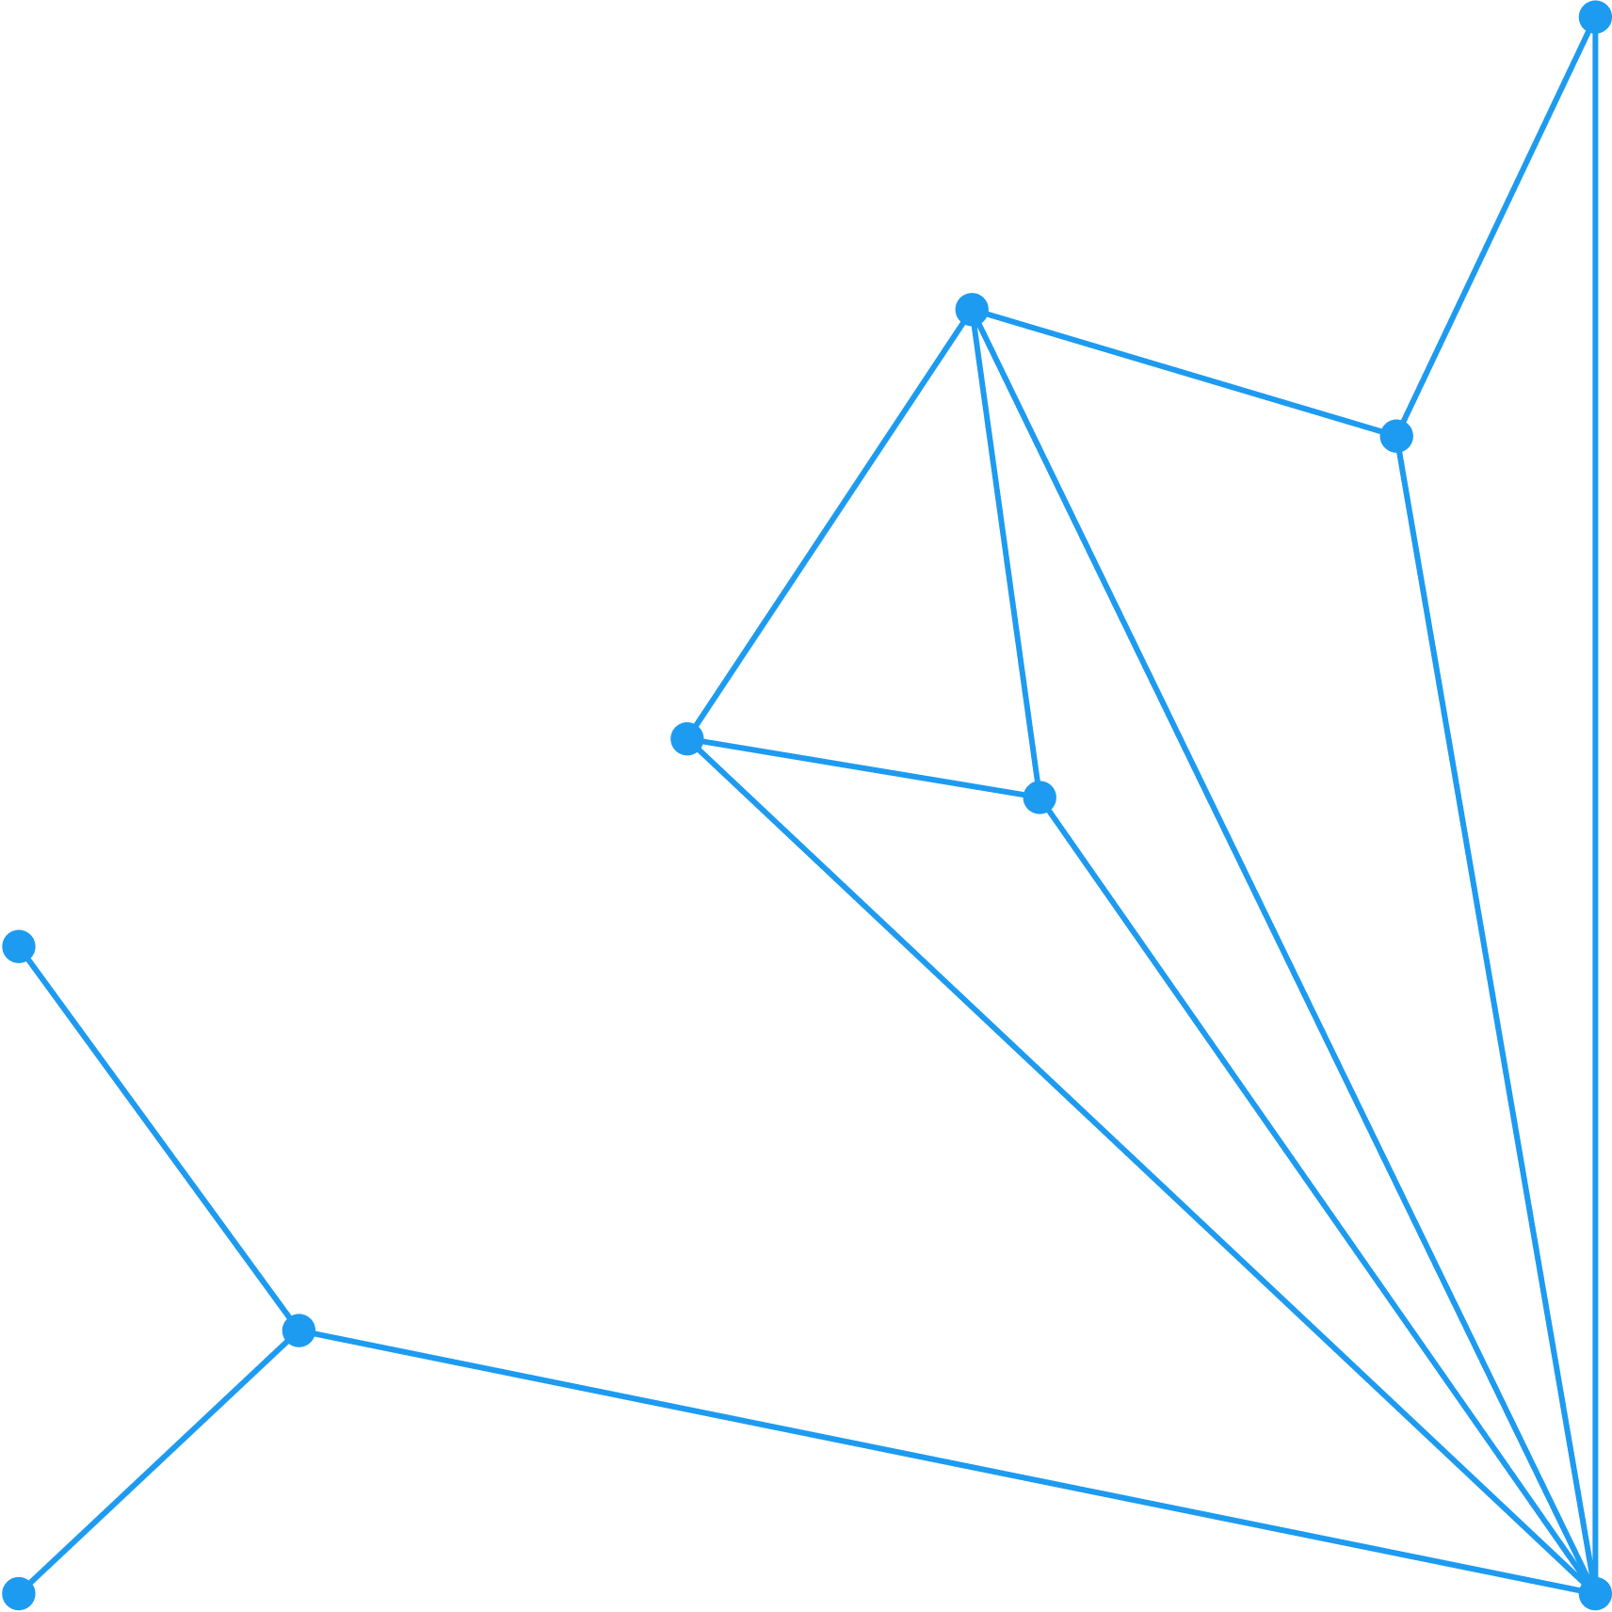





Building a Malaria Model
Elementary Vector-Host Model
BY [Dr. Stephanie Kamunya, Postdoctoral Fellow, CEMA]
1

Slide 2
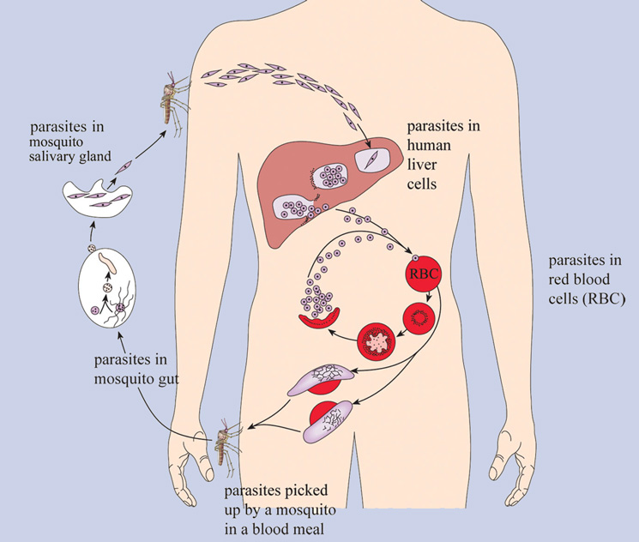
Plasmodium Life Cycle
2

Slide 3
Compartments Involved
Vector Population
Human Population
Susceptible Mosquitoes
(Sm)
Susceptible Humans
(S)
Infectious Mosquitoes
(Im)
Infectious Humans
(I)
3

Slide 4
Flow Chart
Susceptible Humans
(S)
Infectious Humans
(I)
Human Population
Transmission from humans to mosquitoes
Transmission from mosquitoes to humans
Susceptible Mosquitoes
(Sm)
Infectious Mosquitoes
(Im)
Vector Population
3

Slide 5
Parameters Involved
Susceptible Humans
(S)
γ
Infectious Humans
(I)
Human Population
β
Transmission from humans to mosquitoes
Transmission from mosquitoes to humans
α
μ
Susceptible Mosquitoes
(Sm)
Infectious Mosquitoes
(Im)
μ
μ
Vector Population
3

Slide 6
Equations (Vector Population)
δSm = μ_{m}M - β(I/H)Sm – μSm
δIm = β(I/H)Sm – μIm
μ_{m} = Birth/Death rate of mosquitoes
H = Total human population
M = Total mosquito population
3

Slide 7
Equations (Human Population)
NOT so straightforward.
α = host seeking + biting + infectivity rate
α(Sm + Im) -> Number of bites of mosquito population
α(Sm + Im) -> Number of bites PER HUMAN
H
3

Slide 8
Equations (Human Population)
Im -> Infectious mosquito density
Sm + Im
Infectious mosquito density x Number of bites per human
Im x α(Sm + Im) = α Im
Sm + Im H H
3

Slide 9
Equations (Human Population)
δS = - α(Im/H)S + γI
δI = α(Im/H)S - γI
3

Slide 10
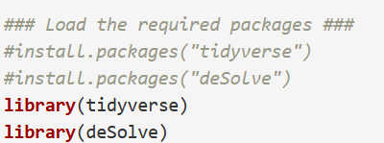
DeSolve Package
Load the Required Packages
3

Slide 11
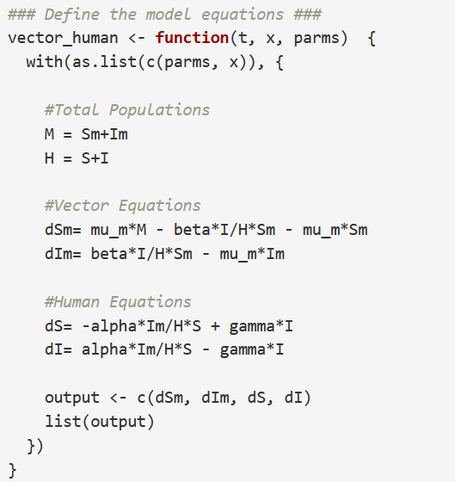
DeSolve Package
1. Define the Equations
3

Slide 12
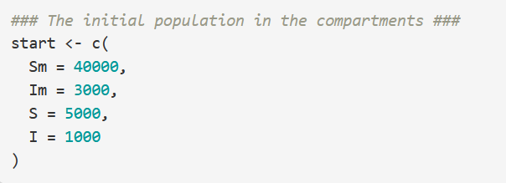
DeSolve Package
2. Initialise the compartments
3

Slide 13
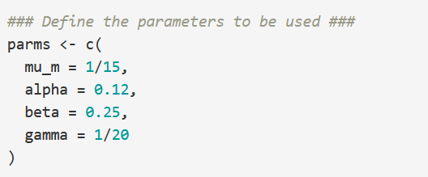
DeSolve Package
3. Define Parameters
3

Slide 14
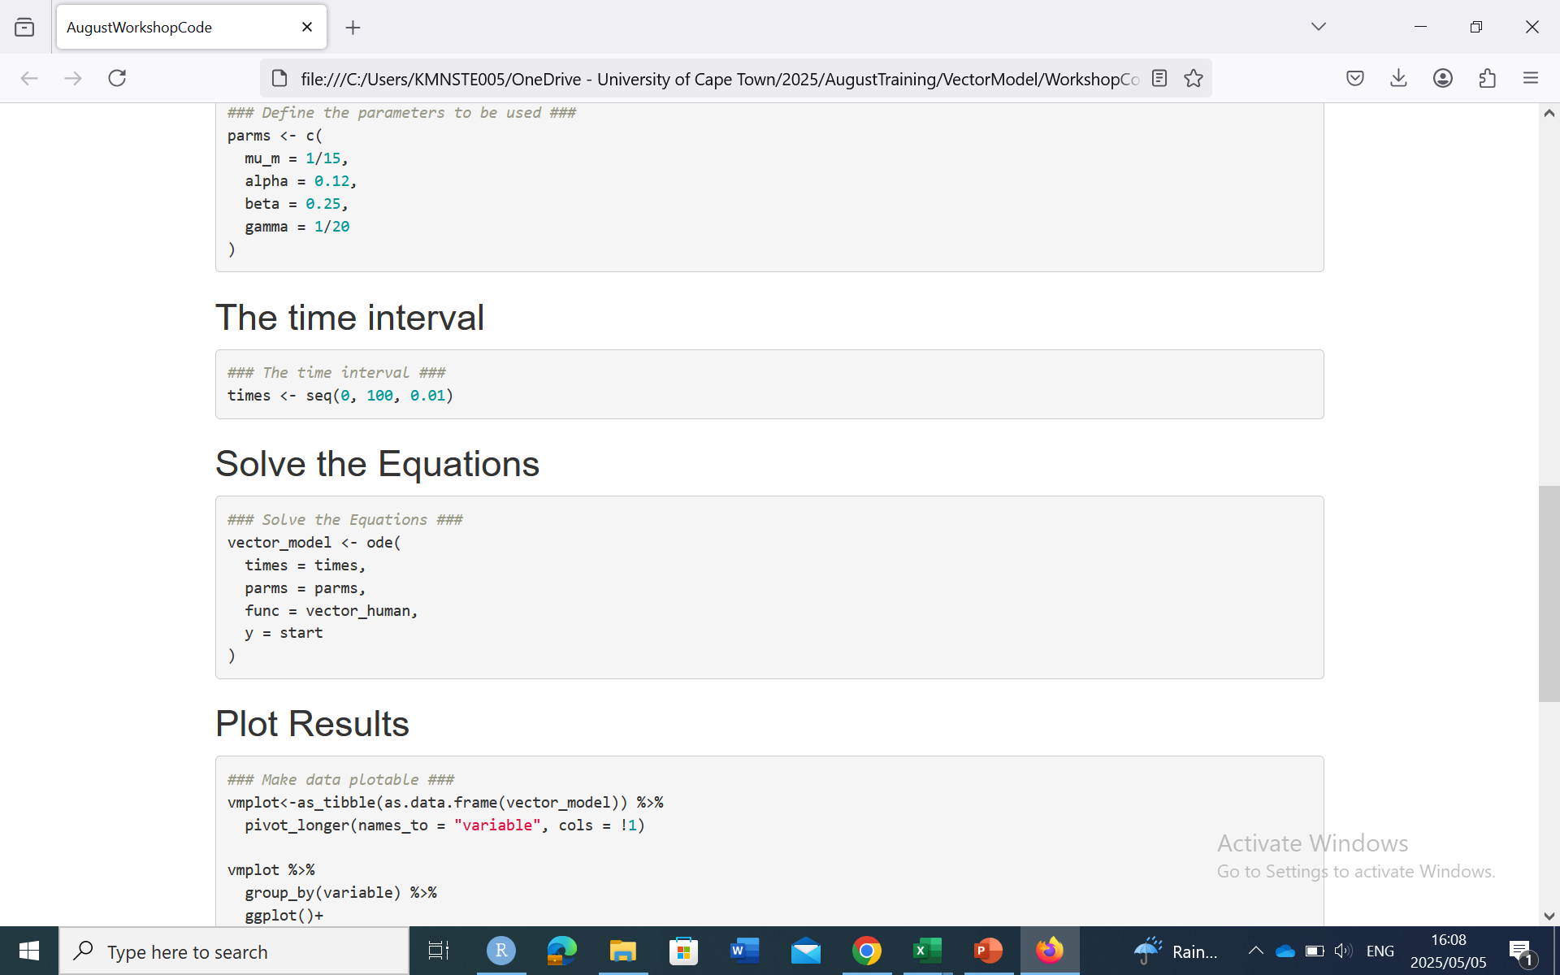
DeSolve Package
3. Define Time Interval
3

Slide 15
DeSolve Package
3. Solve the Equations
3

Slide 16
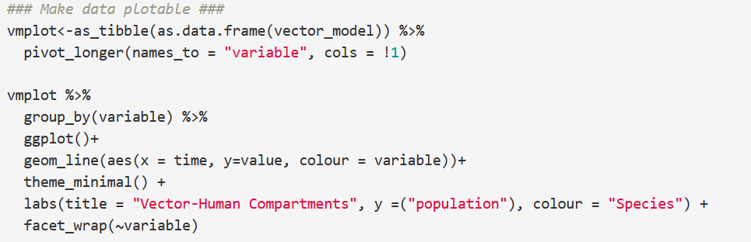
Plot the Results
3

Slide 17
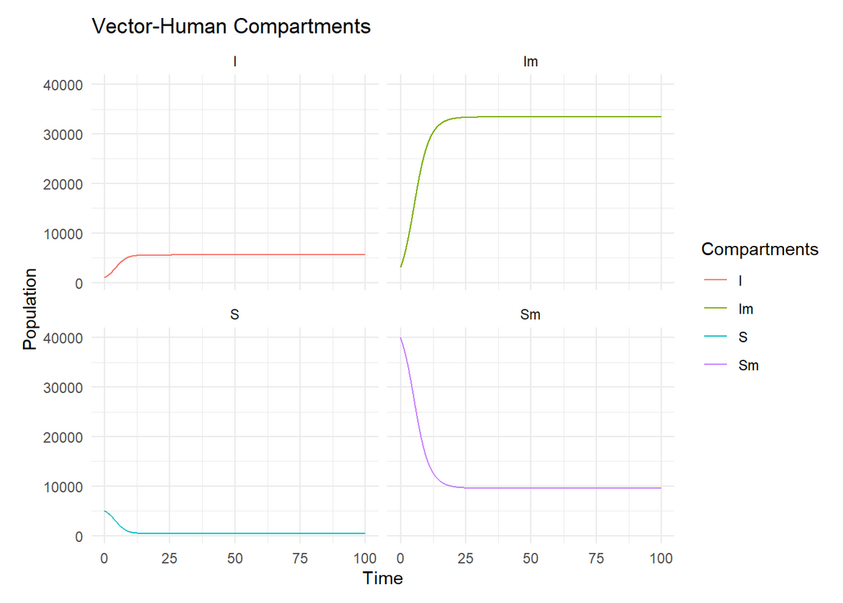
Plot the Results
3

